Slide 1
THE DETERMINANTS OF HEALTH

Slide 2
SYLLABUS CONTENT
STUDENTS LEARN ABOUT:
Individual factors eg. Knowledge and skills, attitudes, genetics
Sociocultural factors eg. Family, peers, media, religion, culture
Socioeconomic factors eg. Employment, education, income
Environmental factors eg. Geographical location, access to health services and technology
STUDENTS LEARN TO:
Analyse how an individual’s health can be determined by a range of factors acting in various combinations

Slide 3
The Determinants of Health - Overview
The determinants of health fall under the following categories of factors: individual, socioeconomic, sociocultural, and environmental. The determinants of health influence the health of all individuals and combine together to affect a person’s health either positively or negatively.
Within each determinant of health category their are various influences on an individual’s health. The syllabus requires that you can analyse how these factors combine to affect an individuals health. That is, how they can multiply the likelihood of an individuals health being positive or negative.

Slide 5
Individual Factors
The individual factors that determine health are factors identified within an individual, including:
Attitudes
Knowledge & Skills
Genetics

Slide 6
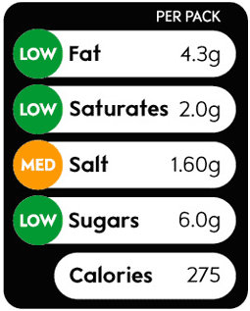
Individual Factors - Knowledge
What a person knows is one of the more influential individual factors that determine health. In order to improve their health an individual needs to have good health knowledge. That is, they need to know:
Where to get information
Healthy food choices
Recommended levels of physical activity
How things affect our health (protective and risk behaviours)
How to interpret food labels, and
Have a wealth of other knowledge related to health
Often health knowledge is linked with health literacy. Health literacy is the ability to understand and interpret health information in order to promote the health of yourself and of others. However, health literacy requires both knowledge and skill.

Slide 7
Individual Factors - Skills
Individual factors such as skill affect the health of the individual. Skills that are related to health include:
Critical inquiry (know who to trust for information)
Research skills (how to find information)
Practical skills such as:
Decision-making
Communication
Problem-solving, and
Movement skills
Such skills can help and individual achieve good levels of health especially when combined with other factors, such as access to information and health professionals, money, and an environment in which they can use these skills in a positive manner.

Slide 8
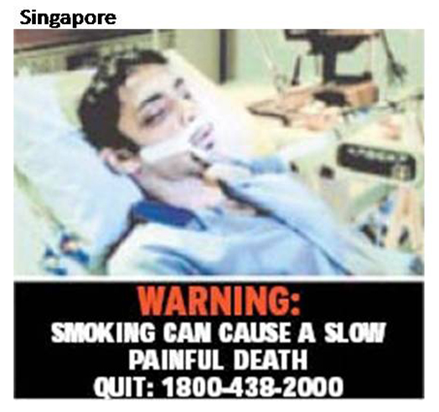
Individual Factors - Attitudes
An individual’s attitude can have either a positive or negative affect on their health.
Often achieving good health requires resilience, perseverance, self-belief and determination. People who value health and have these attributes are likely to achieve better health than those who do not.
Within attitude the value people place on health is pivotal. People who have a high value of health are more likely to prioritise their health over other demands. This relates to time, money and other aspects of life priorities.
For example, a person who highly values their health and has a high level of perseverance is more likely to quit smoking, or not take it up in the first place. They are also more likely to stick to exercise plans and make time to improve their social health as well as their mental and physical health.

Slide 9
Individual Factors - Genetics
Genetics is another of the individual factors that affect health.
Genetics refers to the genes you inherit from your parents. These genes can pre-dispose you to particular diseases or health issues. For example, if your parents have diabetes or cardiovascular disease then you are more likely to also get such diseases.
Furthermore, particular groups of people suffer more from certain diseases and are more likely to develop them.
An example of this is the higher rates of diabetes among indigenous people, as such indigenous people may be genetically predisposed to diabetes (although this is hard to determine with so many lifestyle factors).
Another example is people who are born with white skin and fair hair, who are more likely to develop skin cancer.

Slide 10
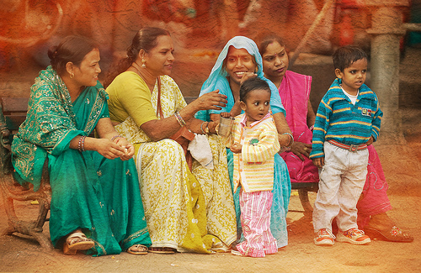
Sociocultural Factors
There are 5 sociocultural factors that determine health:
Family
Peers
Media
Religion
Culture

Slide 11
Sociocultural Factors - Family
Family is by far the greatest influence on health from the sociocultural factors. Family will determine your culture and often have a huge impact on your choice of religion, friends and may even decide what and how much media exposure you have (particularly at a young age).
Your family have a huge influence on your attitude towards health, the value you place on health, and influence your behaviour choices relating to protective and risk behaviours.
For example, if you grew up in a house where your parents eat fast food frequently, you are more likely to think this is normal and even if you know it is not healthy, you are more likely to eat it, because this is what your family are eating.
Conversely, if your family are health practitioners, such as a nutritionist and an exercise sport scientist, then you are more likely to prioritise healthy eating and exercise. However, you may have an overemphasis on physical health and neglect the other dimensions of health.

Slide 12
Sociocultural Factors - Peers
Peer pressure is often the first thing that people think about when it comes to peer influences, however, there is little evidence to say that you are more likely to smoke because your friends tell you to. Instead, your peers influence you by creating environments where you seek to fit into the group by adapting their behaviours. This can be positive, if your group have lots of protective behaviours that they engage in, or negative, if the behaviours increase risk.
During the teenage years, many young people select behaviours that place them within a particular peer group that they wish to belong to.
This may be developing sporting skills to fit in to the group that love sport, or picking up binge drinking if your peers regularly participate in such activities on the weekend.

Slide 13
Sociocultural Factors - Media
The media plays a large role in shaping health. This can be done through marketing campaigns such as “Quit" or McDonalds advertising. It can be direct through news articles that focus on pink ribbon day or TV shows such as “The Biggest Loser”.
However, most of the influence from the media is not so obvious. It is done through regular shows and subtle phrases that promote particular aspects. When a series shows the cool kids smoking, or drinking, or engaging in sexual activity, it makes the viewer start to think that these are behaviours associated with those particular groups. People then begin to seek to live out the character displayed on their screens.
For example, many of our current images used in advertising depict women in sexually seductive or available poses. These are chosen deliberately to get your attention in order to advertise their products, but it also communicates that women are objects to be used sexually and exploited in such ways. The rise in sexual images and videos that are considered normal today cannot be underestimated. Our society is becoming increasingly desensitised to these graphic images leading to increases in sexual assault, harassment, and higher risk sexual activity at younger ages. As we start to think that these things are normal, we begin to act on it which leads to risk behaviours.

Slide 14
Sociocultural Factors - Religion
Religion can often affect your health in a positive manner, providing a purpose for life and promoting self worth. Given that Spirituality is an entire dimension of health, it is no surprise that your religion will influence your health. Often religions also have rules, such as not getting drunk, no sex before marriage, that promote protective behaviours in individuals and promote health.
However, religion can also be limiting. Some religions place restrictions on clothes and social interactions, which can have negative effects on the health of the individual.
For example, a monk who takes a vow of silence and lives in isolation will lack social interaction.
Other religions limit the social interaction between sexes or prevent contact between those belonging to the religion and “outsiders”.
Religion can also limit your choices in relation to health care.
For example, the Seventh Day Adventists will refuse a blood transfusion as it is against their beliefs.

Slide 15
Sociocultural Factors - Culture
Culture is all the traditions, values, and a number of other behaviours, including traditional foods or social activities.
Culture is passed down by the immediate and wider family. A sense of connection and belonging to your culture can have a positive influence on health, especially improving the social dimension of health.
Many cultures have traditional meals which can affect health. The Mediterranean cultures have a diet high in healthy fats and vegetables leading to lower rates of cardiovascular disease. They also have a high value for family, and community increasing social health.
The Japanese have very low intakes of meat and high intake of fresh vegetables, which both positively impact health.
Each culture also has their preferred method of treating illness and fixing the body.
Traditional Chinese Medicine for example uses herbs, and acupuncture as their main medicinal treatments, while many western countries such as Australia and America utilise the pharmacological (drug) method.

Slide 16
Socioeconomic Factors
The socioeconomic factors that determine health include:
Employment
Education
Income
Socioeconomic refers to society related economic factors and these factors relate to and influence one another.
For example – your employment will dictate your income.
Your income level usually correlates to your level of education
Your education helps to dictate your employment

Slide 17
Socioeconomic Factors - Employment
Your employment is your job, what you do for a living. Your employment status and your particular occupation has a large impact on your health.
For example, people with physically active jobs, such as a labourer or a personal trainer are more likely to complete the recommended 30 min a day, 5 days a week for vigorous physical activity.
However, a high level executive who works long hours and sits at a desk all day is less likely to do physical activity, is more likely to be stressed and have a poor social life.
Other examples could include the increased risk of skin cancer in those who work outside, such as life guards or PE teachers. People who work in mines will also have higher exposure to chemicals and breathe in dust as they work, making them more susceptible to lung infections and cancers.
People who work as radiologist spend more time around radiation making them more likely to suffer from cancers. People who work in the transport industry are more likely to be involved in an accident leading to both emotional and physical consequences.

Slide 18
Socioeconomic Factors - Education
Education will not only influence your choice of employment, but your education will directly impact your health. Education does not just refer to your level of education. That is, it does not just refer to whether you complete your HSC, go to University etc. Your education and health can be specific.
Your level of health education includes much of what is taught in PDHPE from K-12. It will include your knowledge about what a healthy diet is, how much exercise you should do, how the 5 dimensions of health interact, and more. But it will also include how well you can do research. Knowing where to get information from, how to know if it is reliable and then interpreting this information in order to make a good decision about your health.
Generally speaking people who have lower levels of education, will also have lower levels of health education, but this is not always true. For example, someone who has had a personal experience of cancer may well know where to find information, who to trust and how cancer works to much greater degree than a PhD graduate who studied business and has not ever really looked into cancer.

Slide 19
Socioeconomic Factors - Income
Income relates to the amount of money coming into your bank account and often the more you earn the better your health can be. People with higher levels of income can afford many of the health care services that are not completely covered by Medicare.
For example, someone with a higher income can afford to see a physiotherapist to recover from a knee injury, while a person from a lower socioeconomic background cannot. They can also afford dental care, to purchase better quality foods (organic etc), pay to join a gym or have a personal trainer, pay for social activities etc.
Essentially, a higher income provides you with better choice. Even the choice of location for where to live, better parks, cleaner home, taking regular holidays etc. It all contributes towards a better overall health status.
Those with a lower socioeconomic status are at higher risk of having poor health. They are less educated, leading to poorer health choices; have less money leading to less health choice, and often work in occupations that provide increased risks to health, such as the transport industry or administrative roles.

Slide 20
Environmental Factors
Environment factors include:
Geographical location
Access to health services
Technology

Slide 21
Environmental Factors – Geographical Location
Where someone lives can greatly determine their health. Within Australia there are people who are homeless, others who live in third world conditions, some who live in rural and remote areas, while many live in cities around the country.
Someone’s geographical location can mean that they are exposed to pollution, or have limited access to fresh water. Geographical location can mean that foods purchased have had to travel further and have less nutrients in them as well as meaning a lack of educational or employment opportunities.
AIHW (Australian Institute of Health and Welfare) also identifies a range of environmental determinants of health, including:
Contamination of food and water
Vector borne diseases transmitted by insects and other animals
Disease caused by air pollution or exposure to chemicals
Injuries that are a results of workplace or traffic systems
Disasters or changes in ecological systems associated with climate change

Slide 22
Geographical Factors cont…
Examples of the environment leading to chronic disease include:
High UV exposure leading to higher rates of skin cancer
Air pollution or dampness or mould exposure leading to respiratory diseases and infections, and increased asthmatic episodes.
Design of the environment - for example, street connectivity, land use patterns, residential density, encourages physical activity and active forms of transport
Where someone lives can influence their access to health services. There are locations in Australia that are hours away from the closest hospital. People who live in rural and remote areas have less access to medical technology and fewer health specialists. Many are required to travel to major cities, particularly for kidney dialysis, which is needed on a regular basis.

Slide 23
Environmental Factors – Access to Health Services
Someone with easy access to health services is more likely to have better health outcomes than someone who has to travel long distances or cannot afford to access particular health services. As such, this environmental factor relates to socioeconomic factors as well as the other environmental factors.
Accessing health services requires both money and physical access. People who live in rural or remote areas have less access to health services, with few specialists, fewer hospitals (with staff shortages), and a shortage of other health care providers, such as nutritionist, physiotherapists, radiologists and more. A lack of access means people who require these services either have to travel to get it, or do not get the benefits at all.
This is particularly the case for those with lower incomes. They cannot afford particular health care services, such as dental, resulting in poorer health outcomes, such as increased cavities, losing teeth, or chronic pain from arthritis. Chronic disease has a very high burden of disease, resulting in people taking me time off work, costing the government more money to treat and people suffer physically, socially, mentally, emotionally and physically from the diseases.

Slide 24
Environmental Factors – Access to Technology
Access to technology includes access to health care technology, such as kidney dialysis machines, as well as access to technology for knowledge, such as the internet.
A person’s access to technology, just like their access to health services, is affected by their geographical location and socioeconomic status.
Accessing surgical technology or the latest hearing technology requires access to the health service that utilise and provide such technology, but also require money.
There are many technologies that are paid for through Medicare within the public health care system, but many are only available through private health providers, meaning they cost the consumer.

Slide 25
Analyse how an individual’s health can be determined by a range of factors acting in various combinations
The following illustration may prove beneficial when analysing how an individuals health can be determined by a range of various combinations
In order to analyse how an individual’s health can be determined by a range of factors acting in various combinations you should first understand what each determinant of health consists of, and identify relationships within them.
For example, education is within the socioeconomic factors and this directly affects the individual factors, such as knowledge and skill. So someone with a Masters in Health Science will have great health related knowledge and skills compared to someone who dropped out of school in year 10.
Furthermore, a person’s environment is greatly controlled by their employment and income. People spend many hours at work, and can only live where they can afford. So, someone who works in the city in an office job spends many hours sitting down. If their job does not pay well, they may live a long distance from their work and have long travel times, increasing their time away from family and social activities.

Slide 26
Interrelating Determinants of Health

Slide 27
Practice Questions
Describe the determinants of health providing an example for each. (4 marks)
How is health affected by the determinants of health? (6 marks)
Provide a detailed example that clearly shows how a combination of the determinants of health can affect an individuals health. (6 marks)
Provide examples of sociocultural factors that may influence health. (3 marks)

